Slide 1
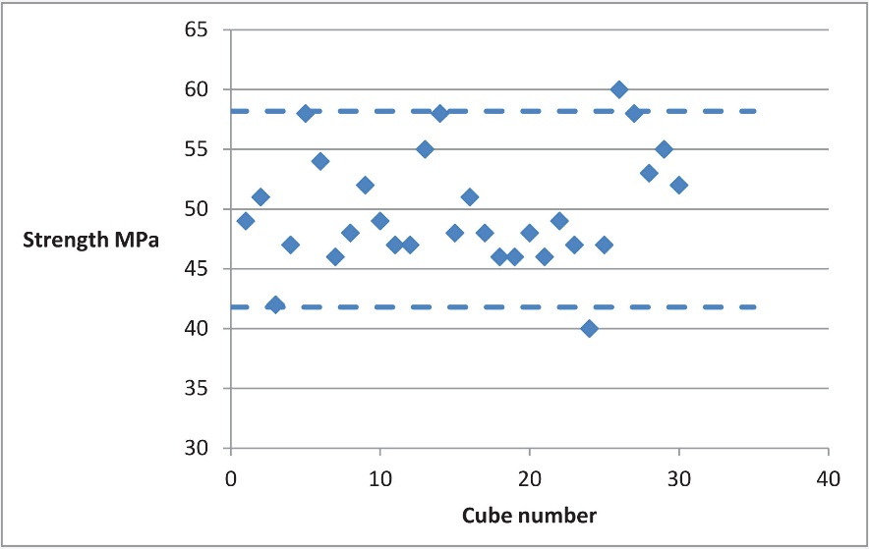
FIGURE 13.1 A Basic Control Chart

Slide 2
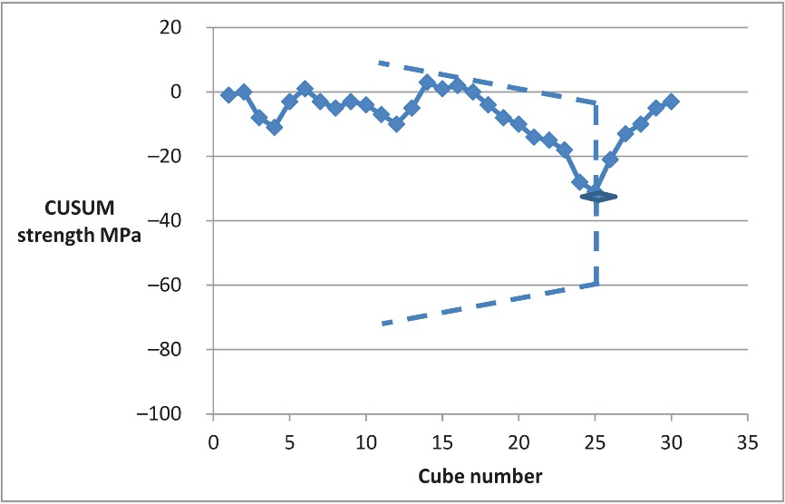
FIGURE 13.2 A CUSUM Chart

Slide 3
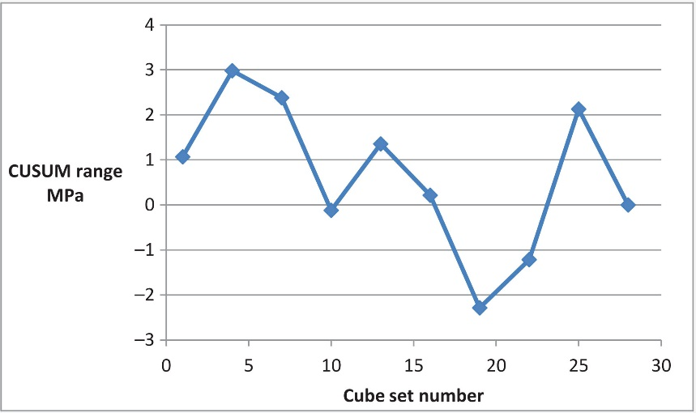
FIGURE 13.3 Plot of CUSUM Range

Slide 4
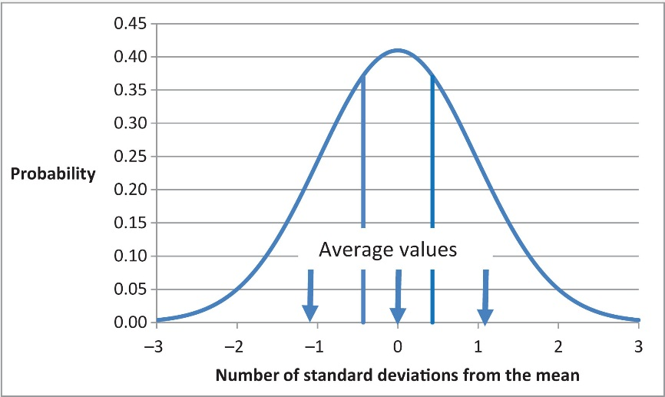
FIGURE 13.4 Dividing the Normal Probability Curve into Equal Areas

Slide 5
